Slide 1
Social and Political Change
Chapter 17 Overview
Brad D. Olson, Jack F. O'Brien, and Ericka D. Mingo

Slide 2
Chapter 17 Learning Objectives
Understand characteristics of dehumanizing and harmful societal structures
Understand which means are most effective to reduce harm when engaged in social and political change processes
Understand how to engage in sustainable forms of activism

Slide 3
Understanding the Long Game
Community psychologists, particularly ones engaged in activism, work to use psychology to confront oppressive people, groups, and organizations
Encourage processes that allow communities to work toward a greater sense of empowerment
Also turn attention toward those who are responsible for dehumanizing structures in society
    Those with power and influence in society who maintain the status quo by inflicting harm on those who lack basic resources and opportunity in society

Slide 4
Community Psychology and Oppression
The Oppressor: The group of individuals who have the power, influence, and power structures in place that further their goals while taking away the rights, needs, and resources of others
The Oppressed: The group of individuals who do not benefit from the power structures in society and lack basic resources, rights, treatment, and opportunity in society

Slide 5
Community Psychology and Oppression, cont.
Community psychologists must pay attention to both the oppressed and the oppressors when clearing paths to liberation through social justice
Community psychologists can work with community members to help them identify aspects of structural violence in order to change those structures

Slide 6
Use of Participatory Means
Community psychologists can align themselves with those in oppressive contexts and collaboratively start directing their attention to dehumanizing structures
It is important to work “with” and not “for” community members
  Rappaport’s Third Way of Empowerment offers a way to balance both the needs and rights of community partners with an aim toward true empowerment
    This is achieved through repetitive dialogue, non-hierarchical organization, and having mutually agreed upon goals
    By embracing paradox, attention is paid to all sides of an issue

Slide 7
Means Matter
The means matter for an activism campaign
Community psychologists can:
  Learn from community members
  Co-design research projects with
  community members
  Engage in activism with agreed upon goals
The ethics, morals, and values held by the community psychologist are vital to ensure the actions taken during a campaign do not compromise the end goal
Alinsky vs Ghandi

Slide 8
Means Matter, cont.
Community psychologists should think critically when partnering with community members
  Make sure not to contribute to the further stigmatization of oppressed community members
  Help community members deal with oppressive factors that they encounter in their daily lives
A self-examination, or self-purification process, is necessary for successful activism
  An honest look at one’s motivations, flaws, biases, and virtues

Slide 9
Class Activity
The text argued that the ends never justify the means. Do you agree with this statement?
Reflect on why or why not.
Alinsky vs Ghandi- which is best?
A self assessment process, is necessary for successful activism
  An honest look at one’s motivations, flaws, biases, and virtues
  How do your attributes prepare or not prepare you for community psychology roles?

Slide 10
Shared Power
Those with power in a group (e.g. leaders) must develop opportunities for others to confront common and harmful narratives, learn from diverse voices, and understand how individuals and institutions benefit from inequality as the status quo.
Participatory Research Projects help us confront our assumptions by taking us out of our own “comfort zone.”

Slide 11
Shared Power in Publication
There are bound to be different roles in larger-scale discussions and social justice projects. Those selected to represent the many have a responsibility to ensure that they represent their group and fairly integrate non-dominant perspectives into the representation. One specific way to achieve this is by selecting primary authors and asking other key stakeholders to review drafts of the final report at several points within the writing process.

Slide 12
Decolonization
Decolonization is a process of examining and undoing unearned privilege resulting from historical and present day injustice.
────
As a process, decolonization can push students from apathy to develop a sense of activism.
Decolonization is a reclaimed historical term that is related to, but different from, social justice. It is a process of thoughtfully removing the leftover impacts of oppression. Communities can decolonize by deconstructing hierarchies and other social structures that support a discriminatory status quo.
Silva, J. M., & Students for Diversity Now. (2018). # WEWANTSPACE: Developing Student Activism Through a Decolonial Pedagogy. American Journal of Community Psychology.

Slide 13
Exposing and Changing the Oppressive Power Structures
One of the most effective ways to challenge power and achieve change is through a system over-reaction
  An action is taken in defiance of those in power
  The powerful react by targeting the activist
  The resulting structural violence captures public attention, aiding the activist and exposing the oppressors

Slide 14
Praxis as an Alternative Process
Praxis provides a framework for the complexities of social and political change
  Cycles of participatory action and research: community input, research, action, and reflection
  These cycles, in turn, lead to small wins in a process that accounts for setbacks
The creation of alternative settings helps activists with the sustainability of their campaign when facing challenges and barriers from those in power
  A collaboration between like minded individuals who support and aid one another throughout the change process

Slide 15
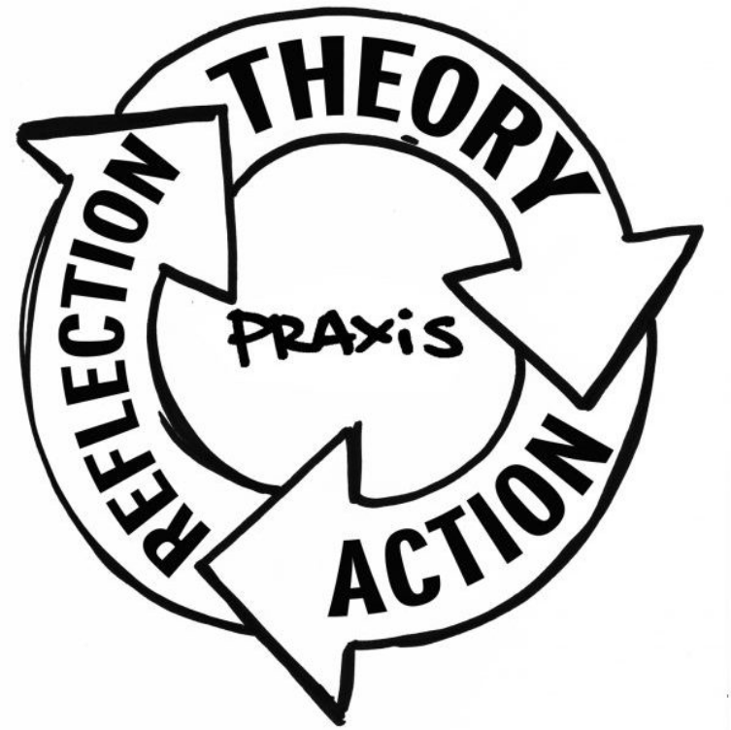
Praxis as an Alternative Process
The creation of alternative settings helps activists with the sustainability of their campaign when facing challenges and barriers from those in power
  A collaboration between like minded individuals who support and aid one another throughout the change process

Slide 16
Sustainability of the Campaign Process
A logic model can be developed that provides an outline, a theoretical structure of how assets and activities are likely to help obtain short-, intermediate-, and long-term goals
  Examine the success of actions short and long term
  Group discussion and revisions to the activism process
  Pacing the process
  Amplification of grassroots efforts

Slide 17
Summing Up
Community psychologists, whether they are practitioners or scholarly activists, try to untangle the blocking points and hurdles to social change
  Work as a collaborative group
  Use an ecological lens
  Self-examine
  Engage in the praxis process

